Slide 1



Username = iMap Username
first three letters of first name
& last name (in full)
EXAMPLE: johsmith
PASSWORD: “changeme2018”
iMapInvasives Mobile App Training
Help find small, manageable infestations
Meg Wilkinson
Invasive Species Database Program Coordinator
NY Natural Heritage Program
Notes:
Thank you for inviting me to speak
Impressive group

Slide 2
How Can iMap Help You?
Local Level:
  Search for invasive species & enter observations
  View nearby areas …. What is approaching the region?
  Record treatment/management efforts
  Great communication tool for organizations, especially over time
State/PRISM Level:
  iMap sends nightly emails to PRISM Leaders, and state experts of new observations submitted to iMap – aware of high priority “finds”; assist with confirmation process
  Refer to iMap data when prioritizing summer crew work
Notes:
Lake Associations have many concerns
One of them is invasive species
And one tool that is available for you is the state ISDB, iMapInvasives

Slide 3
Objective Today
Learn how to login to online iMap:
  View data on the map
  View data in a table
  Search/Query for data
Learn how to submit invasive species data to online iMap using a smartphone with the iMap Mobile app & view online

Slide 4

Intro
PRISMs Partnerships for Regional Invasive Species Management
Importance of Early Detection
Online – Map & Table
Online – Query/Report & Email Alerts
iMapInvasives
Online
iMapInvasives
App
App – Download/Set Preferences
App – Record an Observation
App - Upload; Test & View Online
Wrap-Up
8 Things You Can Do – by Megan Phillips
Questions
Notes:
Overview of state efforts – ISAW and PRISMs
Let you know about iMap, a resource available to you
And want to empower you to have an iMap login and know how to submit an observation from your phone
FLY IN
Special today – trying to make this as close to in-person as possible
iMap Section – follow along
PLUS Tech hour – personal assistance via phone and email

Slide 5
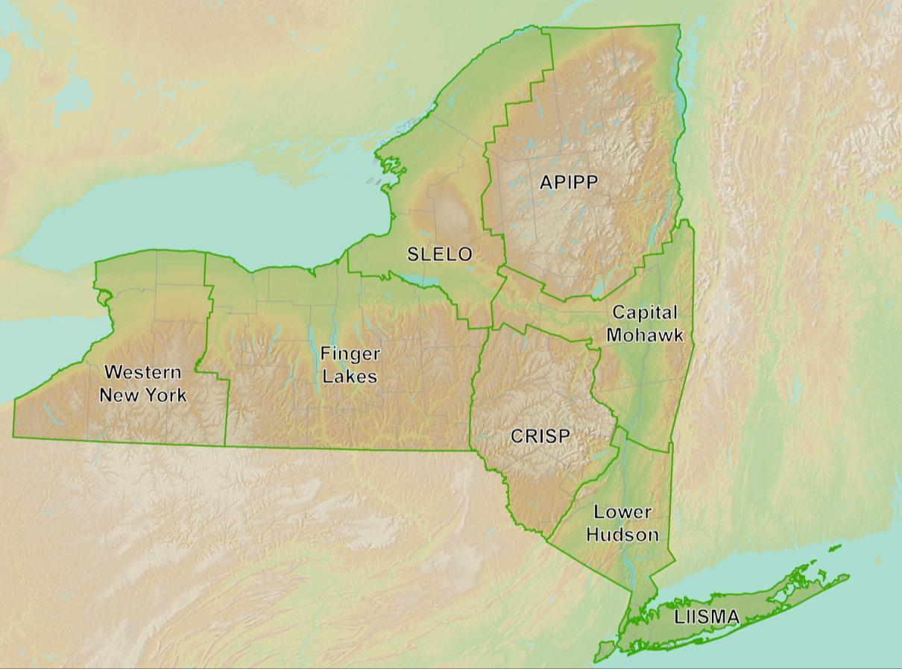








Partnerships for
Regional Invasive Species Management
Notes:
Network
Natural Resource Managers, volunteers, water chestnut pulls, strike teams, etc.
Fortunate – state is covered (CISMA – leftover cookie dough)

Slide 6
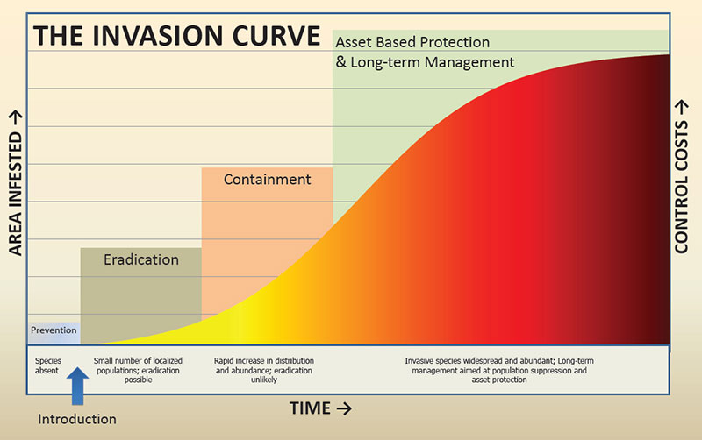
Notes:
At ANY scale – preserve; county; PRISM; state
Why? Sooner is better; knowledge is key – small or isolated? Nearby?

Slide 7

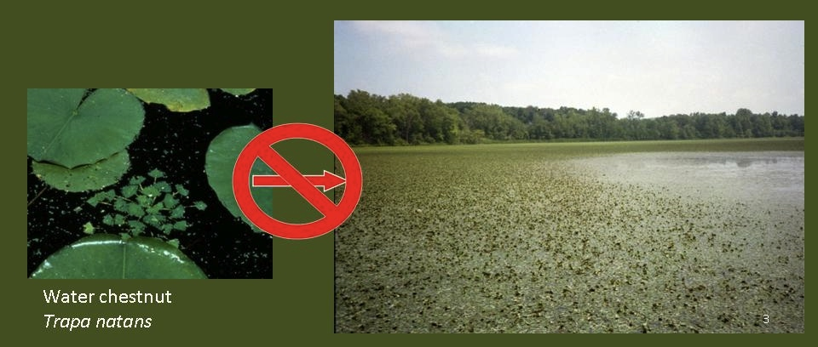
Notes:
For any species
Goal is to find things early when they are manageable
Water chestnut is one that is manageable if it is a small infestation; my neighborhood; 15 years
Flier – water chestnut chasers Challenge

Slide 8
Intro
PRISMs Partnerships for Regional Invasive Species Management
Importance of Early Detection
Online – Map & Table
Online – Query/Report & Email Alerts
iMapInvasives
Online
iMapInvasives
App
App – Download/Set Preferences
App – Record an Observation
App - Upload; Test & View Online
Wrap-Up
8 Things You Can Do – by Megan Phillips
Questions
Notes:
Overview of state efforts – ISAW and PRISMs
Let you know about iMap, a resource available to you
And want to empower you to have an iMap login and know how to submit an observation from your phone
FLY IN
Special today – trying to make this as close to in-person as possible
iMap Section – follow along
PLUS Tech hour – personal assistance via phone and email

Slide 9

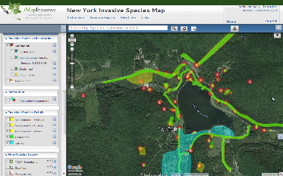

Our mission is to facilitate conservation of New York's biodiversity by providing comprehensive information and scientific expertise on rare species and natural ecosystems to resource managers and other conservation partners.
Partnership between NYS DEC and SUNY ESF
A collaborative GIS-based, online tool for invasive species management
New York State Invasive Species Database
Notes:
NYNHP mission
iMap – a part of NYNHP

Slide 10
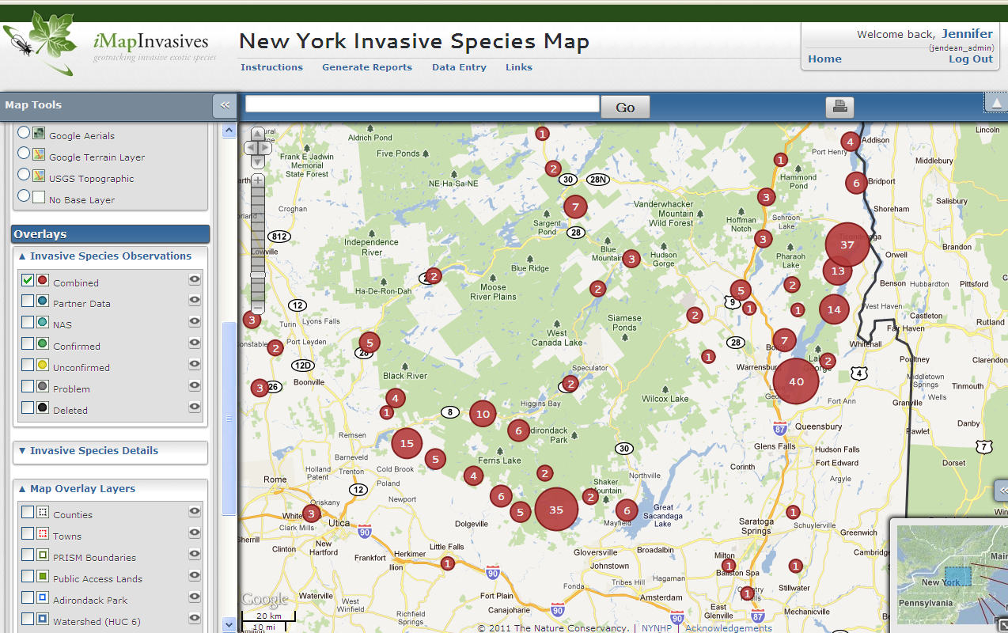
2010: Live in New York!
Notes:
iMap has evolved in the past 7 years – software, data, participation

Slide 11
Where does the data come from?
1) Bulk uploads from partner organizations
Local, State, and Federal Agencies
Land/ Water Managers
Researchers
Museum Data
Notes:
50+ organizations have contributed invasive species data to iMap
Data exchange with NYFA,CSLAP, etc

Slide 12
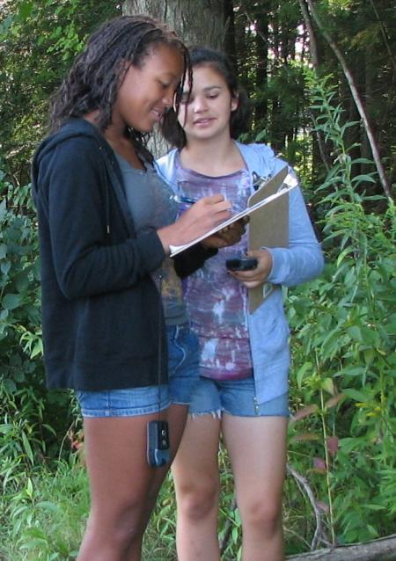
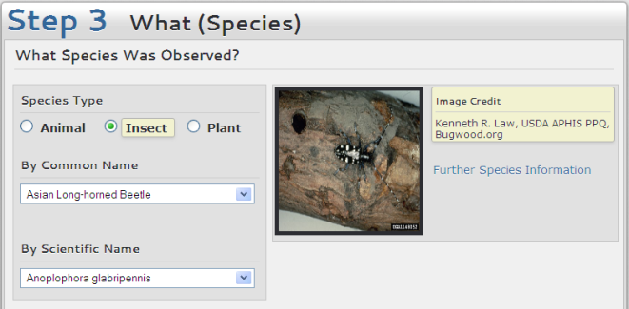
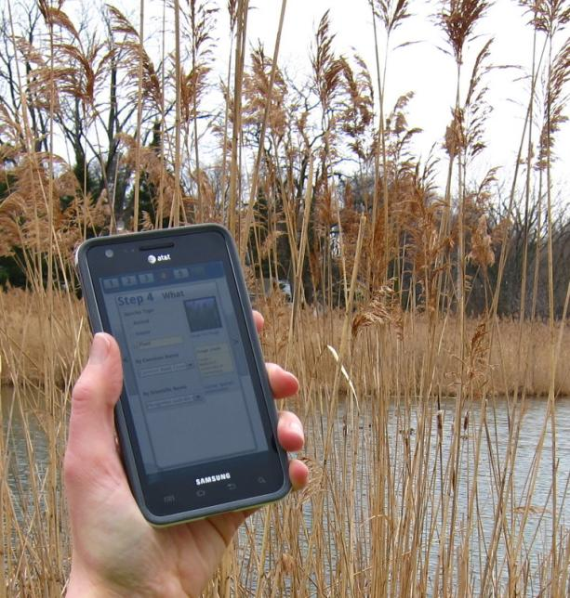
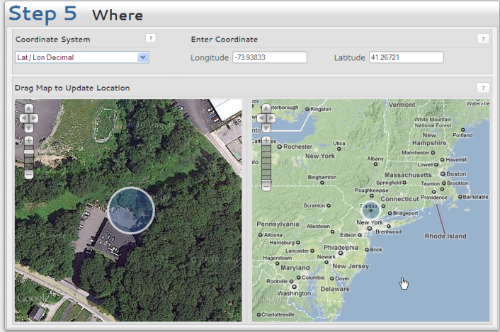
Where does the data come from?
2) User data entry for observations
Online (computer)
App (smartphone: Droid, iPhone)

Slide 13
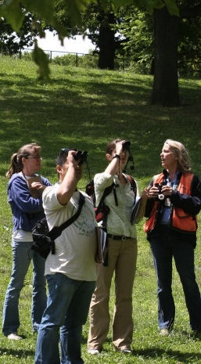
Data from professionals and citizen scientists
OBSERVATIONS
Organization Bulk Uploads: 150,000
Online Data Entry: 36,000
Mobile App (since Fall 2015): 8,470
TOTAL: 194,000
Trained iMap Users
>3,000 since 2010
Species type | Observations
Aquatic Animals | 14,393
Aquatic Plants | 23,527
Insects | 7,660
Terrestrial Animals | 472
Terrestrial Plants | 150,161
Notes:
2016-06 mobile app: 1,100

Slide 14
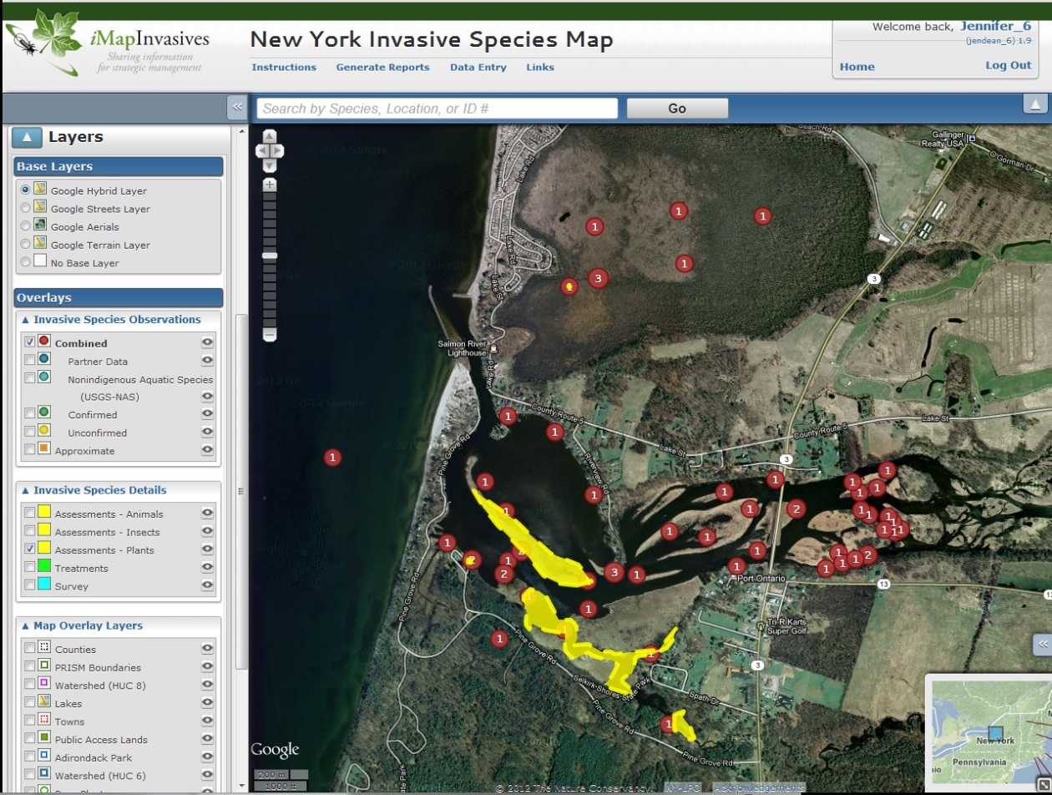
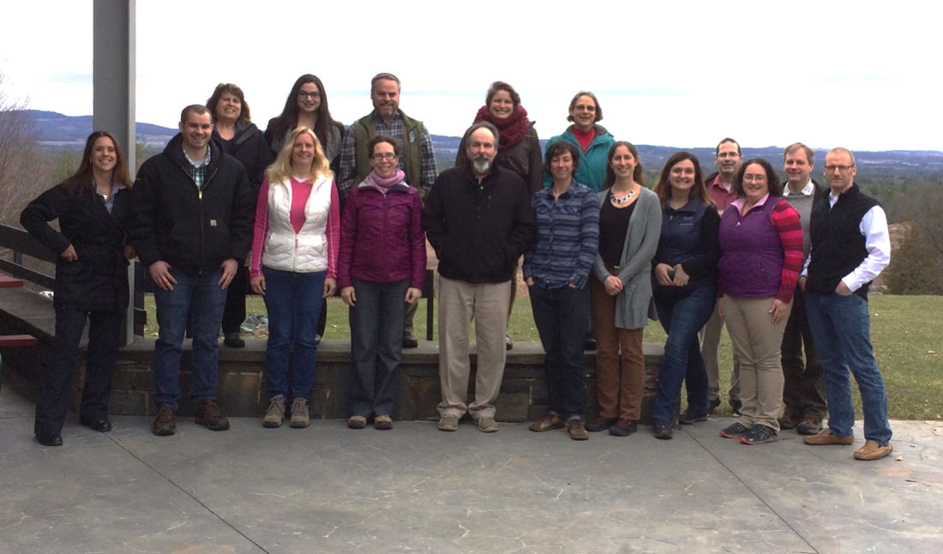


Who uses iMap?
Key Reports
Jumps &
Anomalies
Contributing to
NYS Knowledge Base &
Informing EDRR Work &
Response Efforts
Botanists/Ecologists
Consultants
DEC staff
Parks staff
CCE staff
Master Gardeners
Outdoor Enthusiasts
College Students
Managing a Geography
NYS DEC Invasive Species Program Staff
PRISM Leaders
HWA Initiative
NYS Parks
Lake Associations
Town/County staff
Notes:
Two worlds:
Knowledge base → EDRR & Response efforts “Key Jumps & Anomolies” – something out of place - one invasive or small patch in an area otherwise not invaded
Managing a geography
Show of hands for managing a geography?
And Everyone: Eyes on the Ground contributing data to inform invasive species work; makes a big difference to the statewide effort

Slide 15
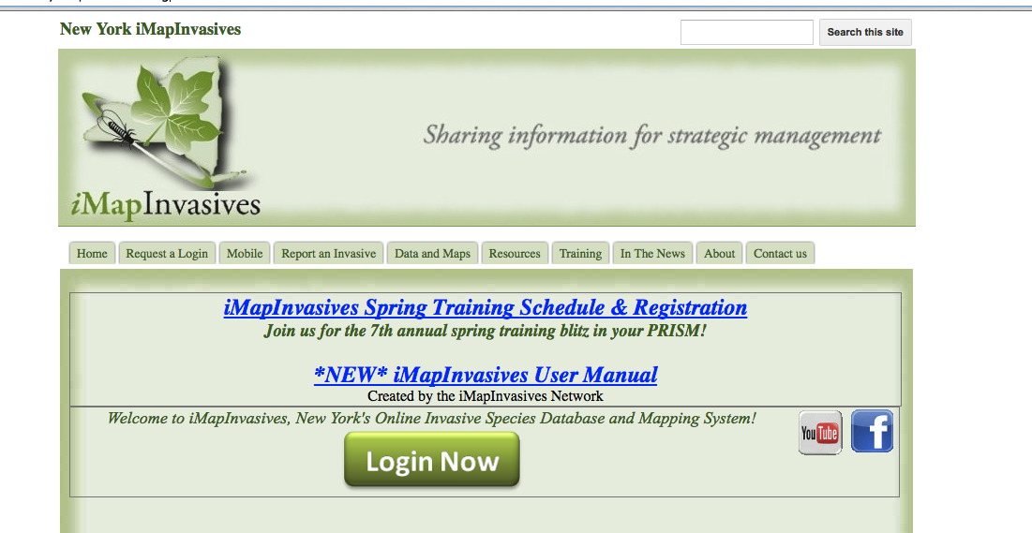
www.NYimapinvasives.org
Notes:
Take home – remember this website
Nyimap – Resource; lots of info – water chestnut
HOW TO REPORT – need a login – registered for webinar – you have a login; if you did not register for the webinar → request a login
Mobile – app store/play store & minimums
ONLINE Login Now → use the username and password from your email

Slide 16
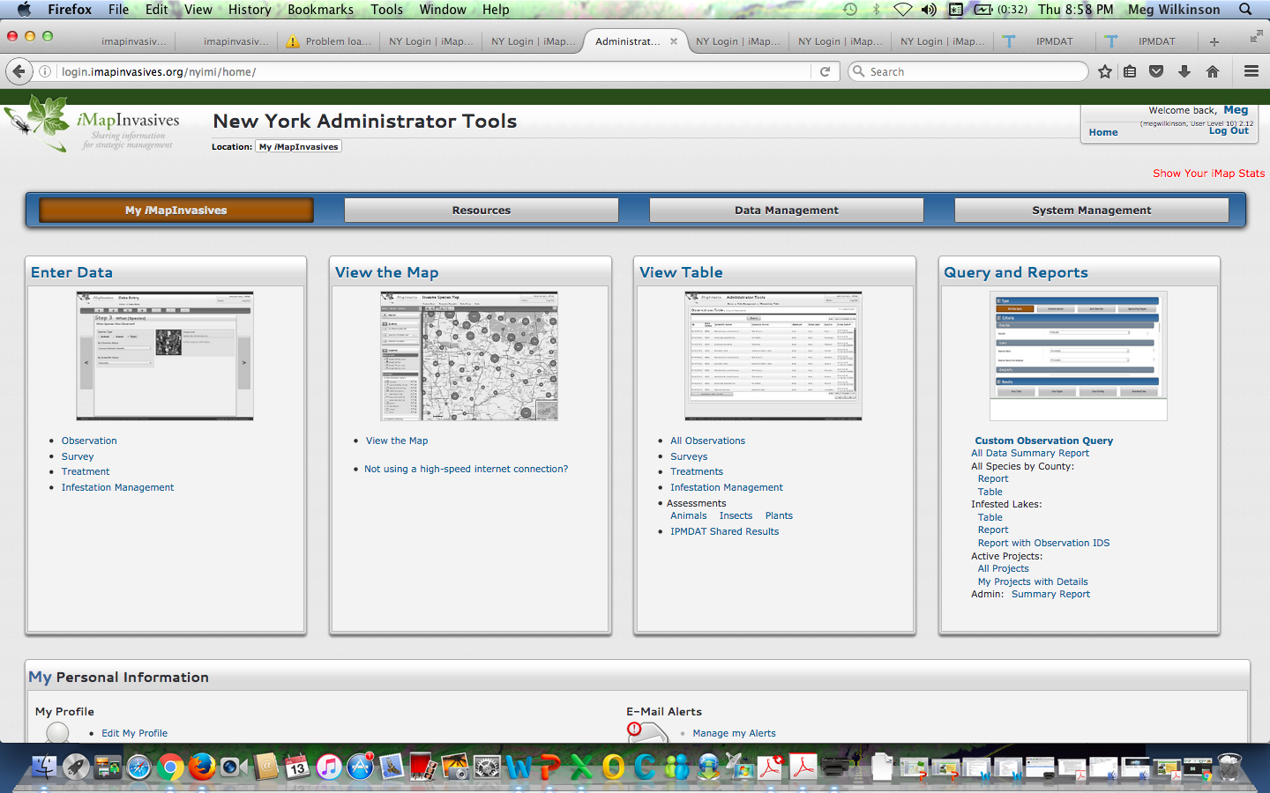

Slide 17
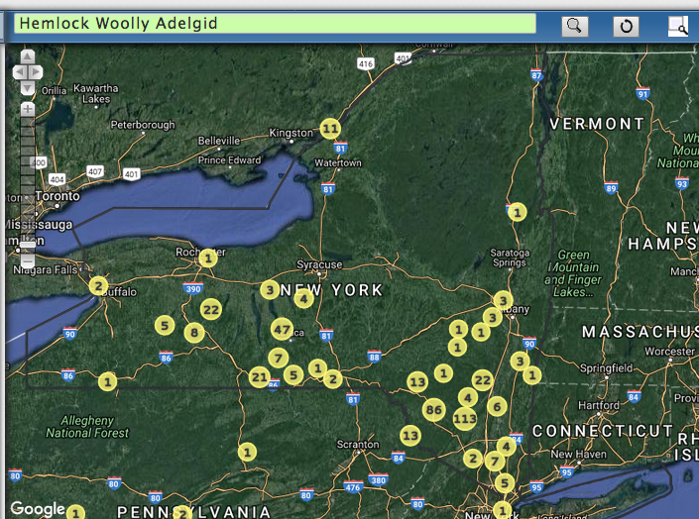
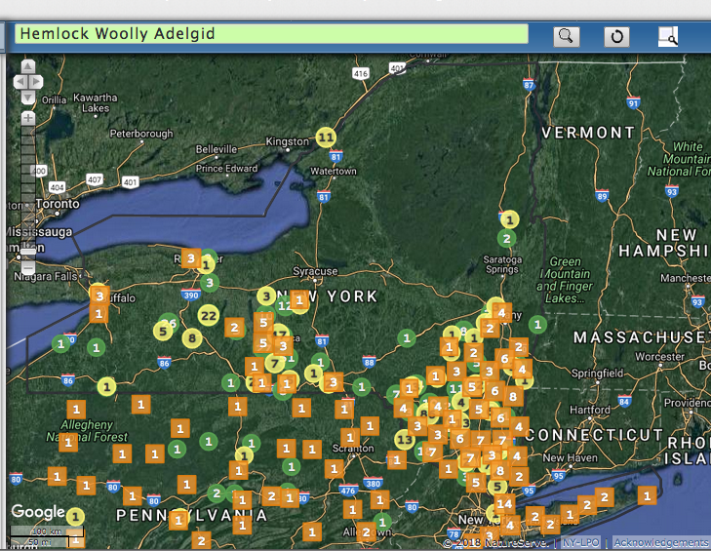

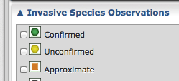
Notes:
Map:
Confirmed
Unconfirmed
approximate

Slide 18
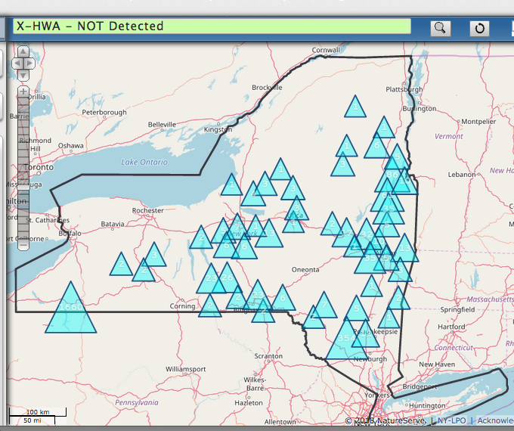
X-HWA-Not Detected

Slide 19
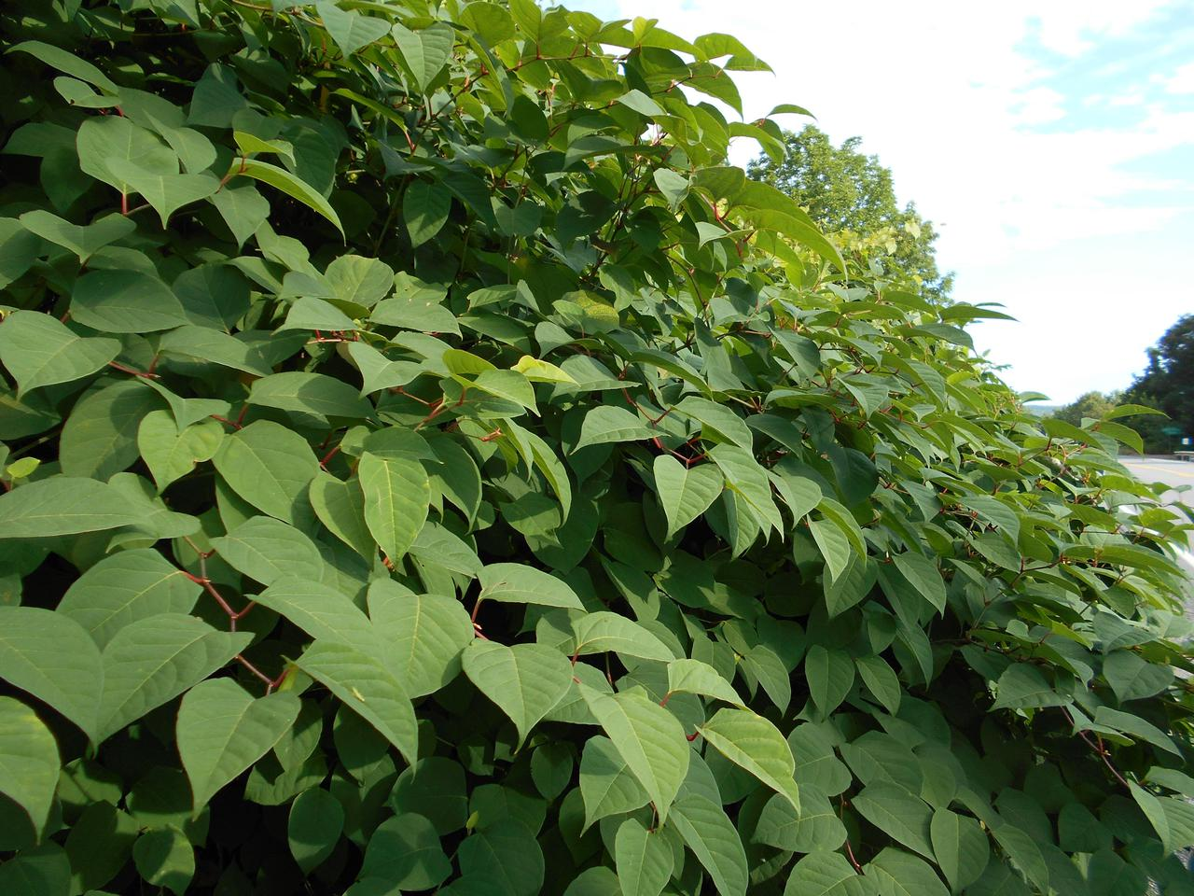
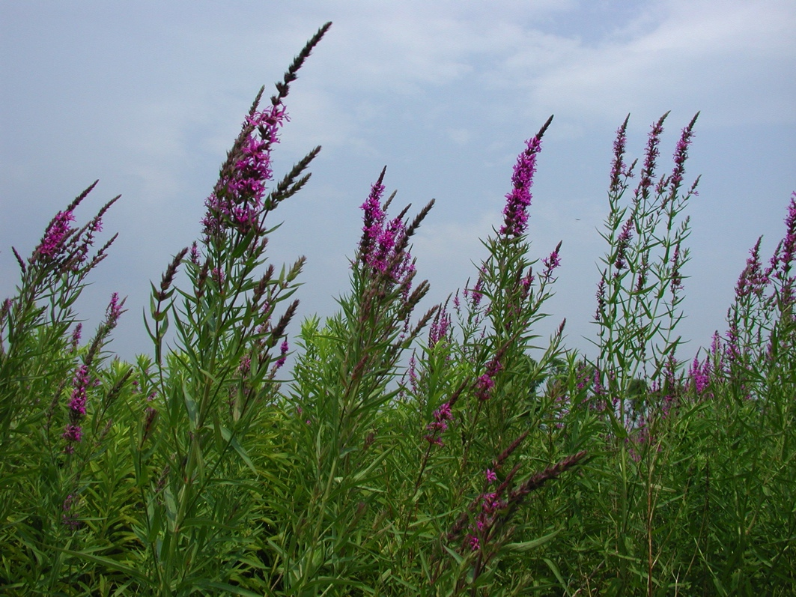
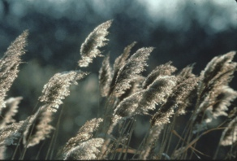
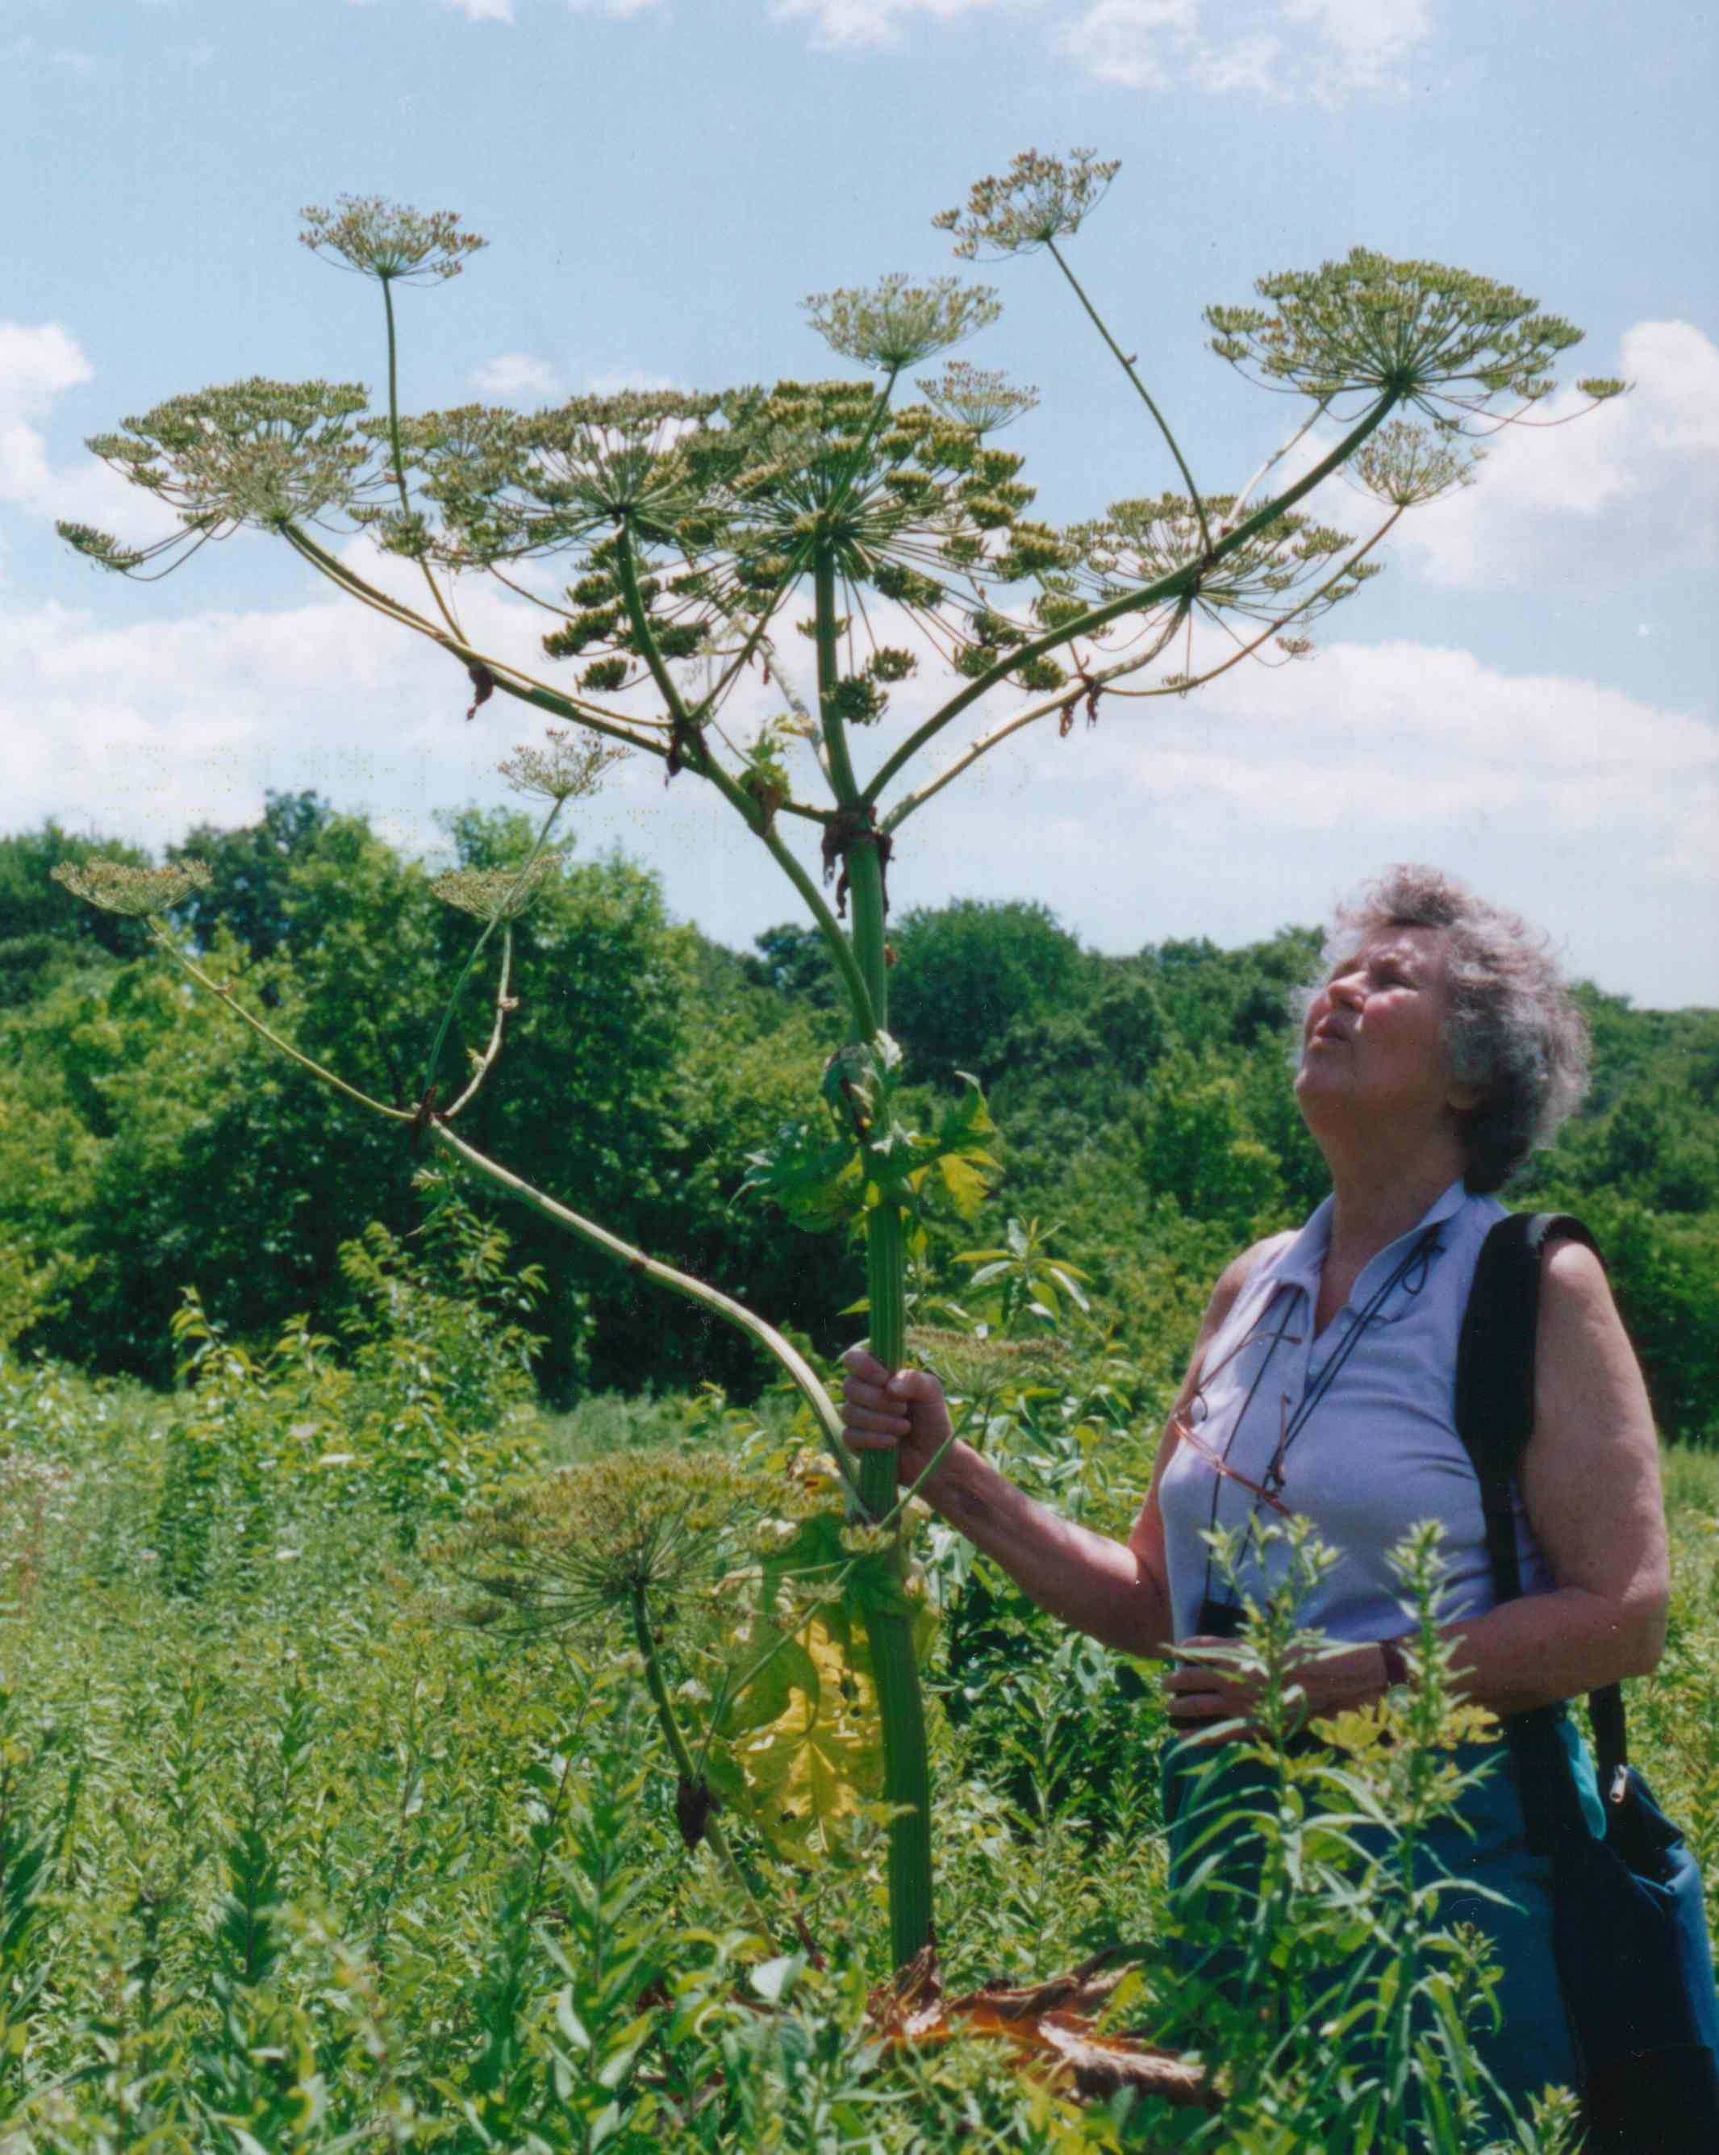
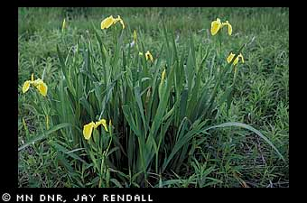
Notes:
Nearly 200,000 observations…. Many different species – explore online
Point to pics – ask for ID…

Slide 20
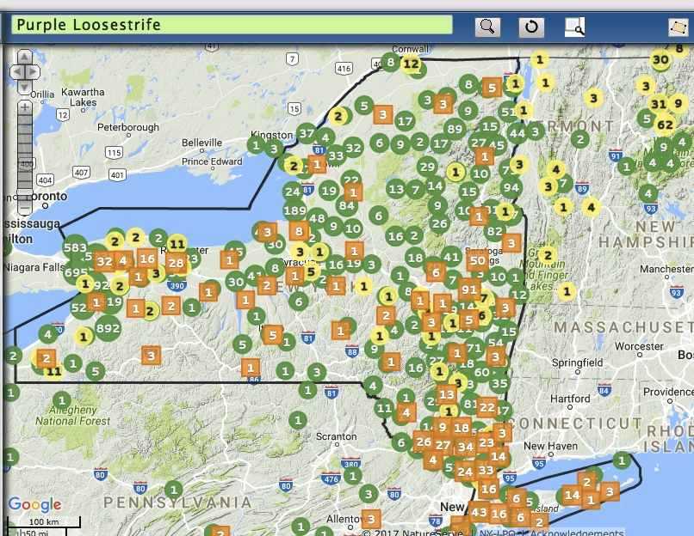
Notes:
The # = the # of obs; zoom in & break apart

Slide 21
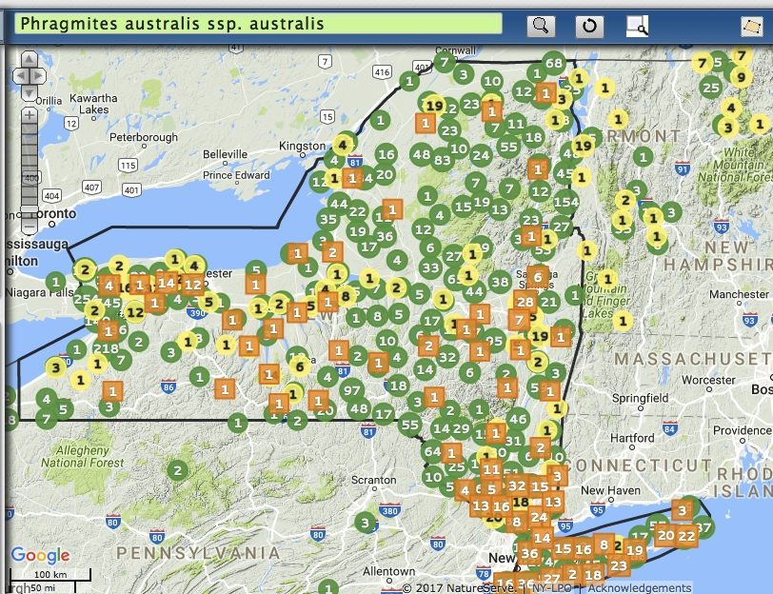
Notes:
Story…. 2010 - ADK

Slide 22
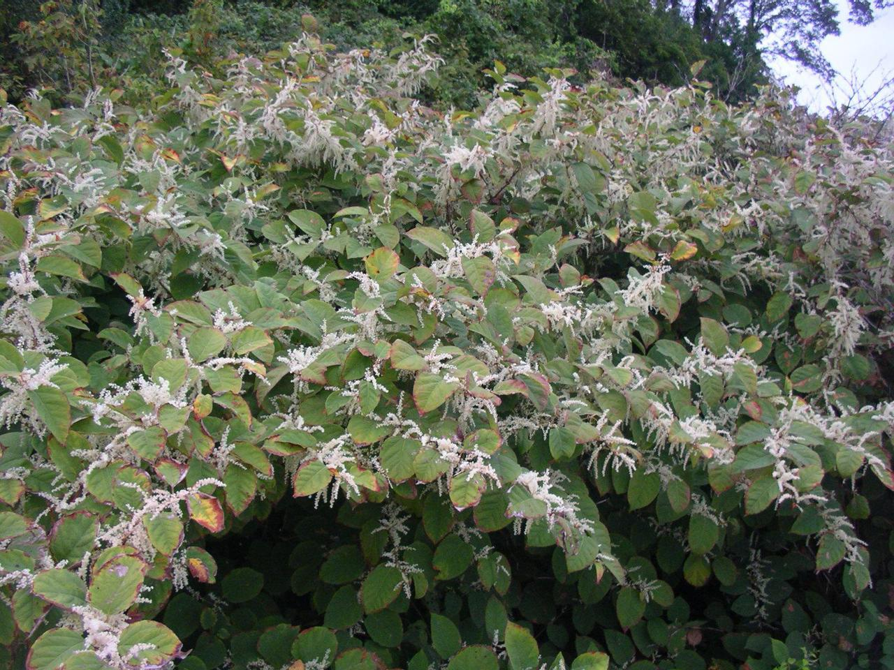
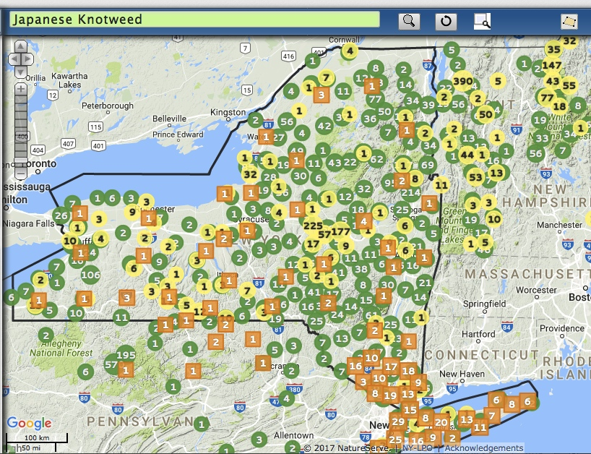
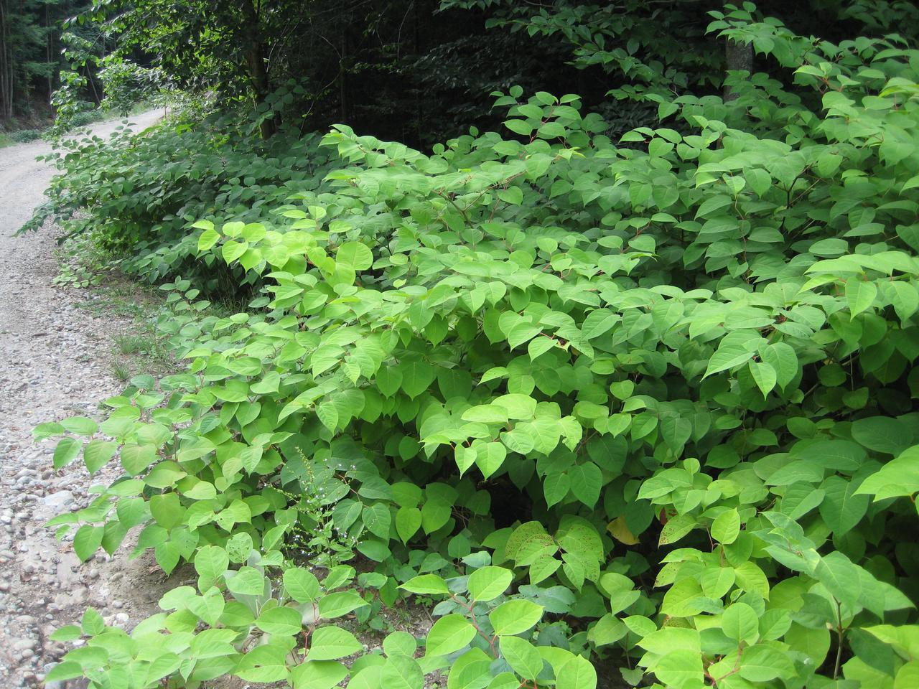
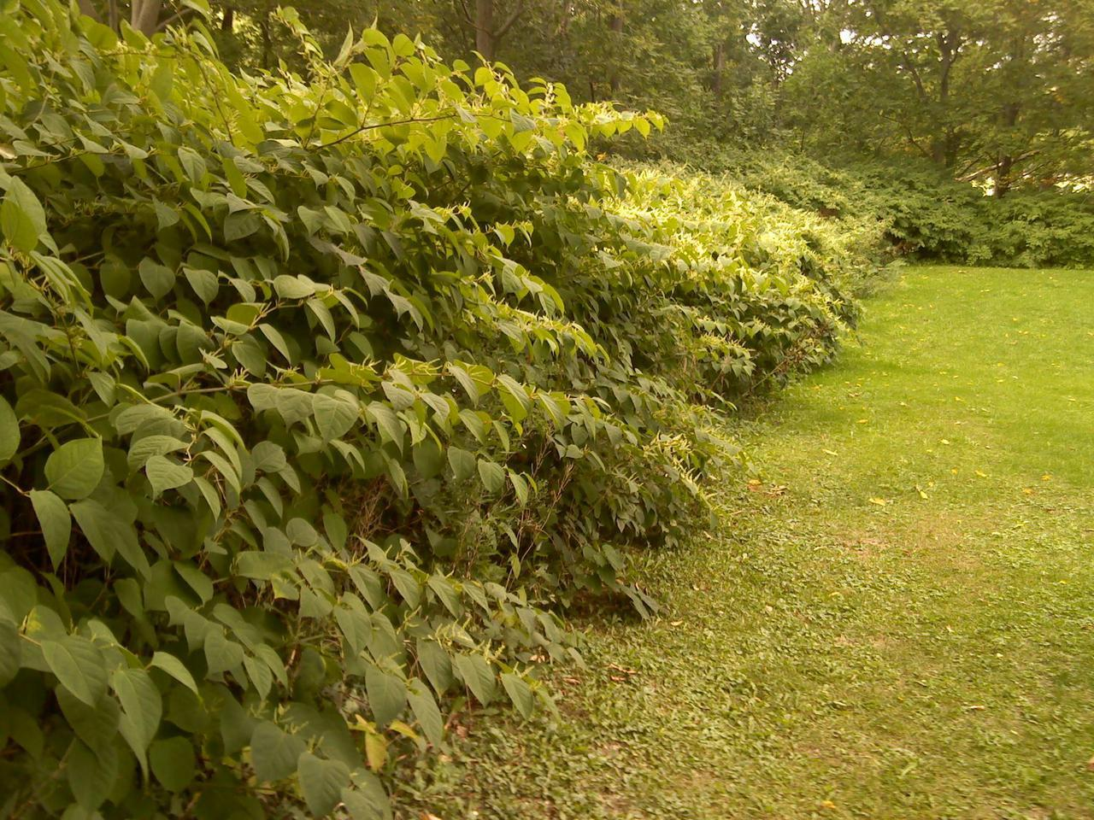
Notes:
SLELO – Rob Williams – Salmon River

Slide 23
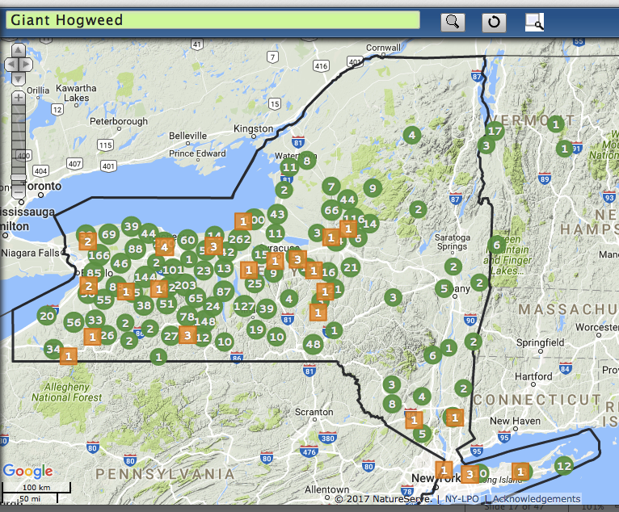
DEC
Notes:
Treated
Naja Kraus with DEC led strike team for several years

Slide 24
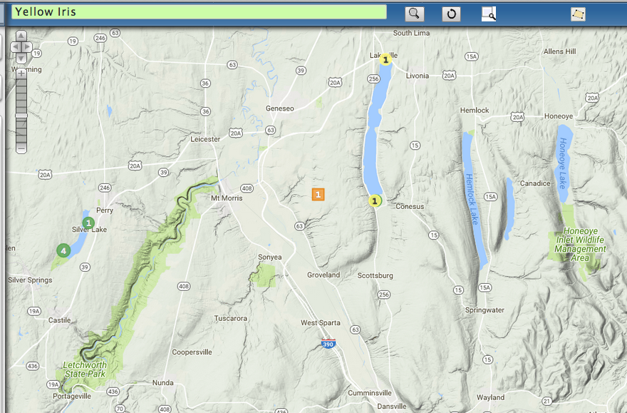
Yellow Iris

Slide 25
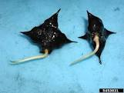
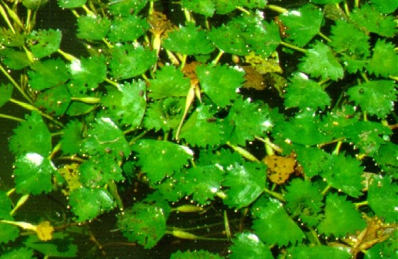
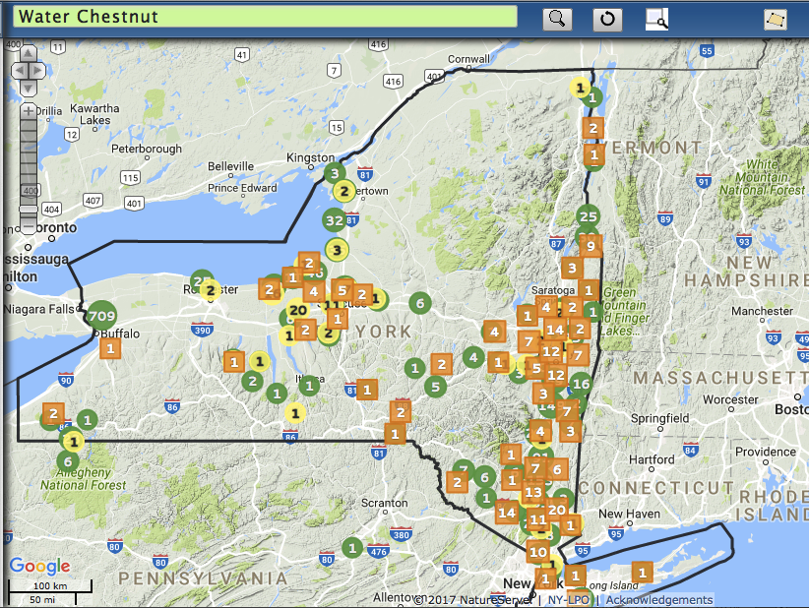
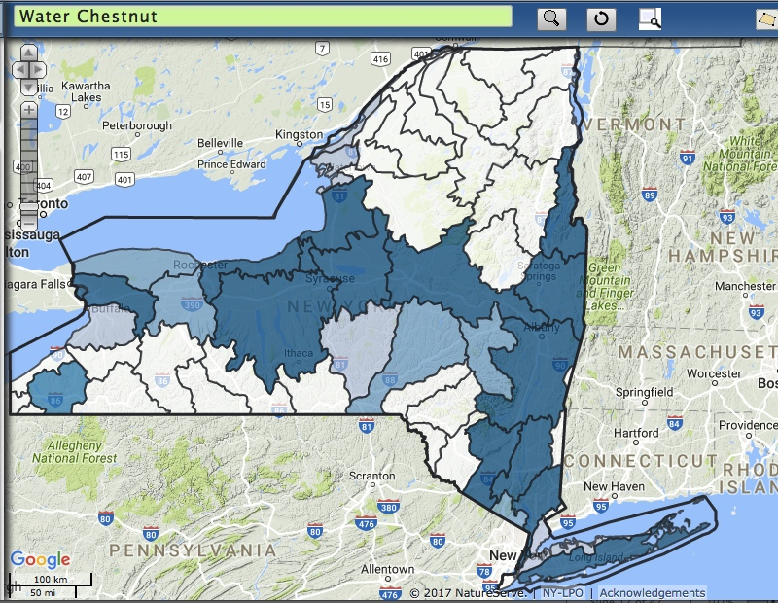
Notes:
Water chestnut
Sometimes simple distribution map is helpful; looking at the data through the watershed lens, insightful
And by watershed

Slide 26
Where to Focus:
Species Prioritization by PRISM
Tier 1 – not present
Tier 2 – might be able to eliminate it
Tier 3 – manage on local basis
Tier 4 – well-established

Slide 27
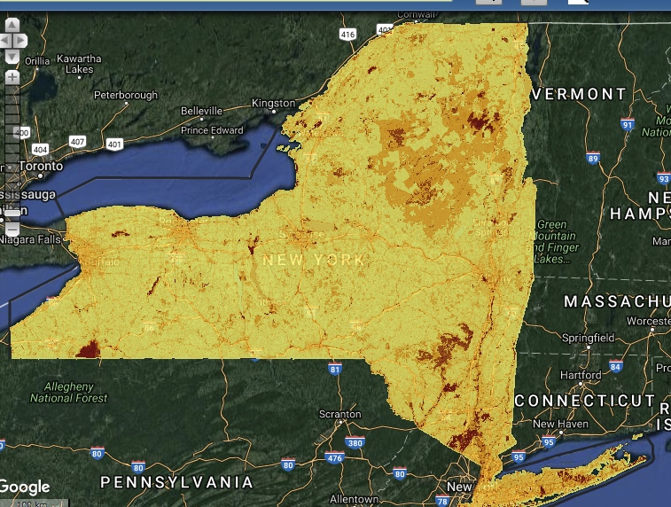
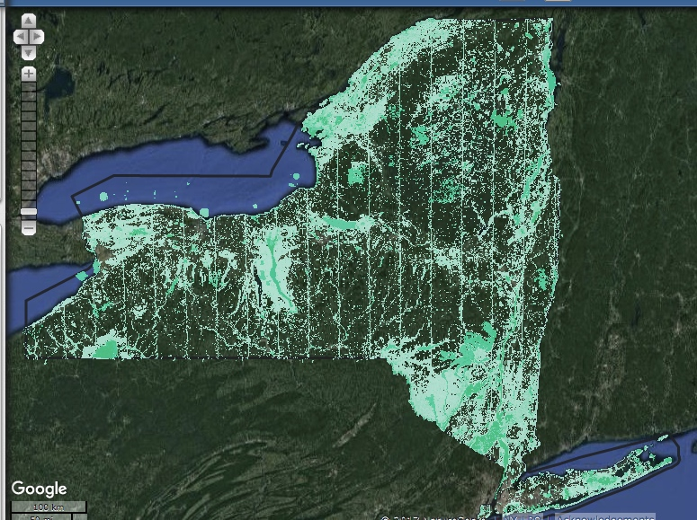
Spatial Prioritization: Where to focus?
High Quality Natural Areas
With high risk of spread
Ecological Significance
Notes:
Also, recently added to iMap
Some modeling work that Jennifer Dean, the Invasive Species biologist led with a GIS Spatial Analyst and a working group
Handout at the iMap table; and poster
High quality natural areas + high risk of spread
Components also availabe – ecological significance + protected areas + risk of spread

Slide 28
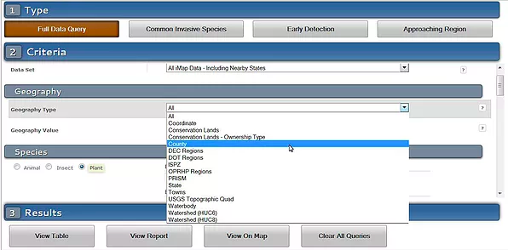
Notes:
Many more query and reports
Powerful query tool to search for specific data
By county; by watershed; etc.
What’s nearby; approaching region report

Slide 29


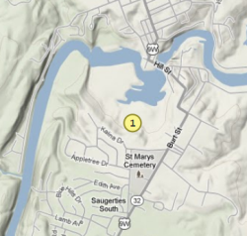

Email Alerts
Communicating important findings to stakeholders
Alerts sent to
state authorities
Regulated or
High Priority Species
Verified by expert
Other
Species
Reviewed by state iMap administrator
Set to “confirmed” by state iMap admin
User email alerts
Notes:
Data IN → word OUT →
And of course one of most important goals of having all the invasives data in one place for your state is for communicating important findings to your partners. iMap has an email alert system…
Action → PRISM leaders, Scott K, Mark Whitmore, and others around the state will know that new data has been entered
And YOU can set up alerts for county/park/watershed etc.

Slide 30


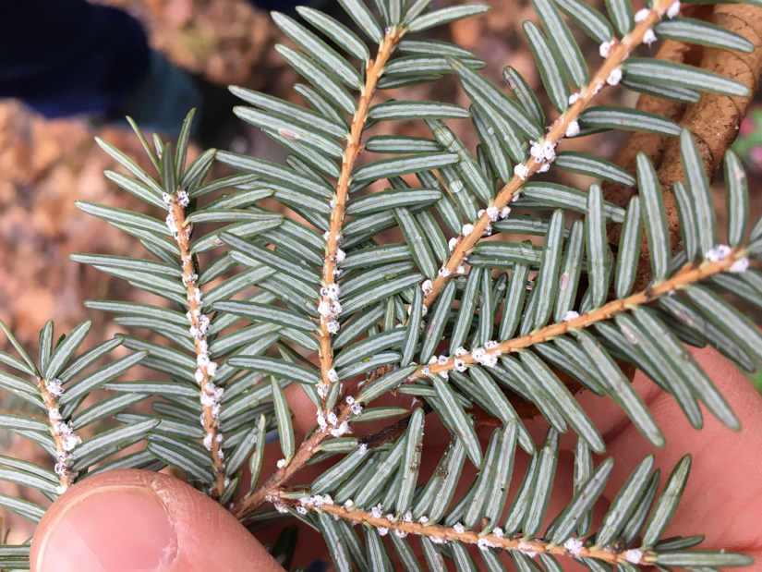

Project
Group data
Project Leader: confirm/ review data
Download data
Notes:
Staff turnover; ongoing projects; over time
Projects are a way to keep track of work being done under a specific grant or
for a specific project such as a high school class project or 4-H project.
Projects can only be set up by an iMapInvasives administrator. The
project leader will then request a Level 5 user access for that project. Pr
oject leaders will beable to download
all the invasives data that is entered for their project.
HWA photo – Jessi Lyons CCE, from iMap

Slide 31
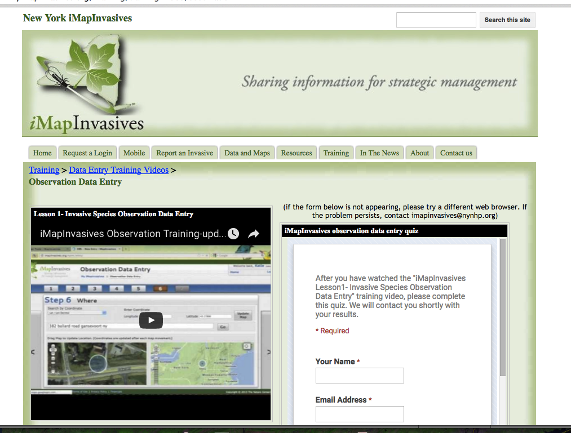
Enter data online
Notes:
Two ways to enter obs data; ONLINE - Training – if you prefer to enter observation data online – short video will walk you through the steps …

Slide 32
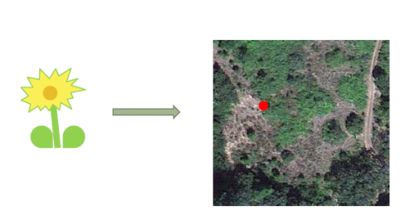

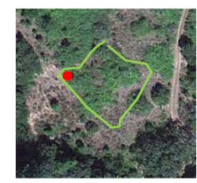
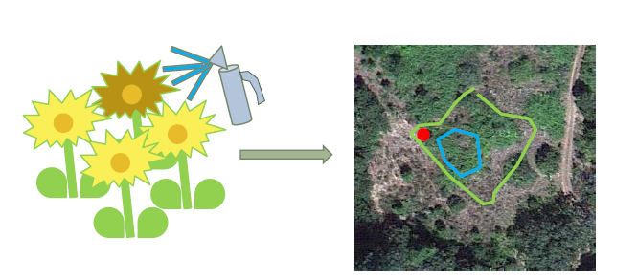
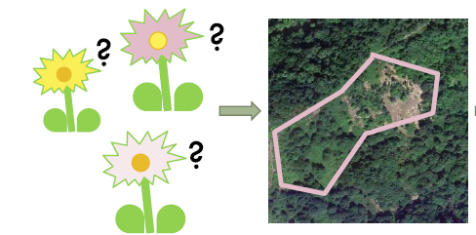
OBSERVATION – location of a specific species(location, date)
ASSESSMENT – detailed information about a specific observation
INFESTATION
MANAGEMENT
RECORD
TREATMENT – control effort details
SURVEY – search for presence or absence of a species
Notes:
Obs App or Online
Other data types – Online;
App – observation, only

Slide 33
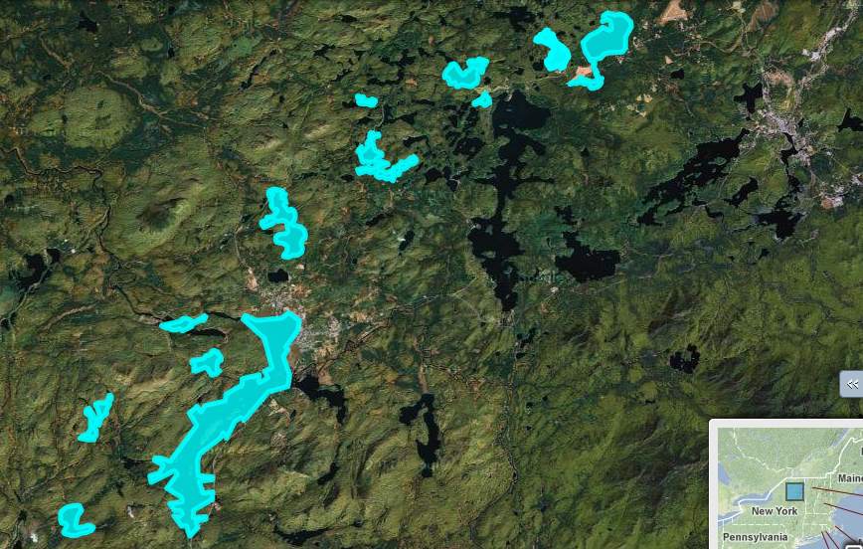
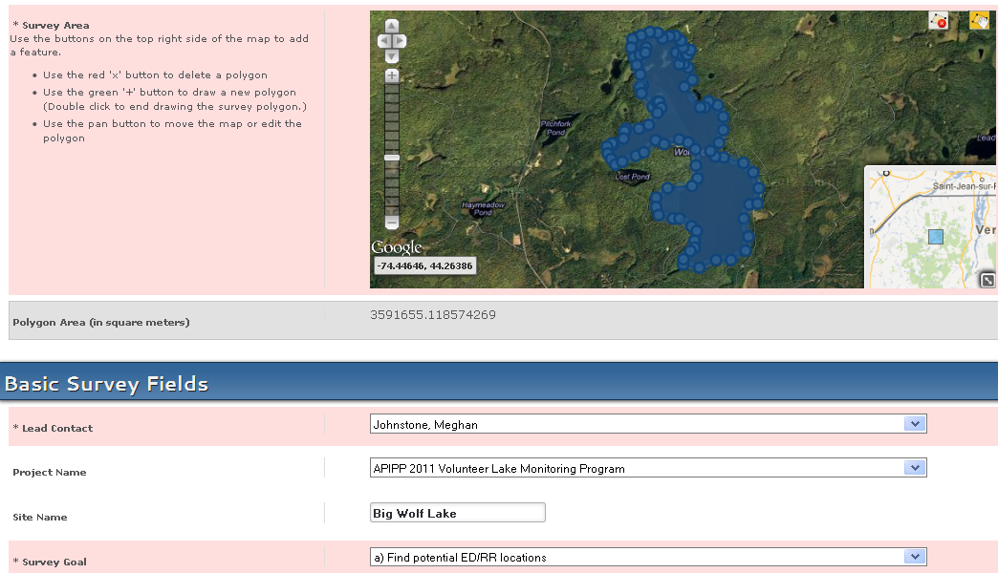
Online: Managing advanced data
Managing a Geography
Notes:
Track change over time

Slide 34
Username = iMap Username
first three letters of first name
& last name (in full)
EXAMPLE: johsmith
PASSWORD: “changeme2017”
Intro
PRISMs Partnerships for Regional Invasive Species Management
Importance of Early Detection
Online – Map & Table
Online – Query/Report & Email Alerts
iMapInvasives
Online
iMapInvasives
App
App – Download/Set Preferences
App – Record an Observation
App - Upload; Test & View Online
Wrap-Up
Watercraft Inspection Station Program App (“WISPA”)
8 Things You Can Do – by Megan Phillips
Questions
Notes:
Overview of state efforts – ISAW and PRISMs
Let you know about iMap, a resource available to you
And want to empower you to have an iMap login and know how to submit an observation from your phone
FLY IN
Special today – trying to make this as close to in-person as possible
iMap Section – follow along
PLUS Tech hour – personal assistance via phone and email

Slide 35
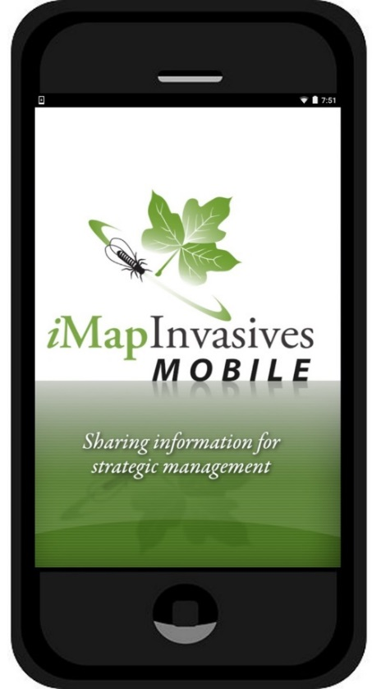


The iMap Mobile app is a convenient way to collect new records for viewing and editing on the full online interface
(You will use the same iMapinvasives username and password for both)
Data Server
iMapInvasives Mobile App
Collect observations using your phone GPS and camera. Upload to server on wi-fi.
iMapInvasives Online
Full browser-based mapping functionality to search the data, produce maps, and enter data, from new locations, to detailed treatments and surveys.
Notes:
Shift gears now …. Covered online… now cover the app…
The app is a great, easy way to collect data,
but the online interface still holds all the power features.
People need to log in online occasionally to check all their data collected with the app.

Slide 36
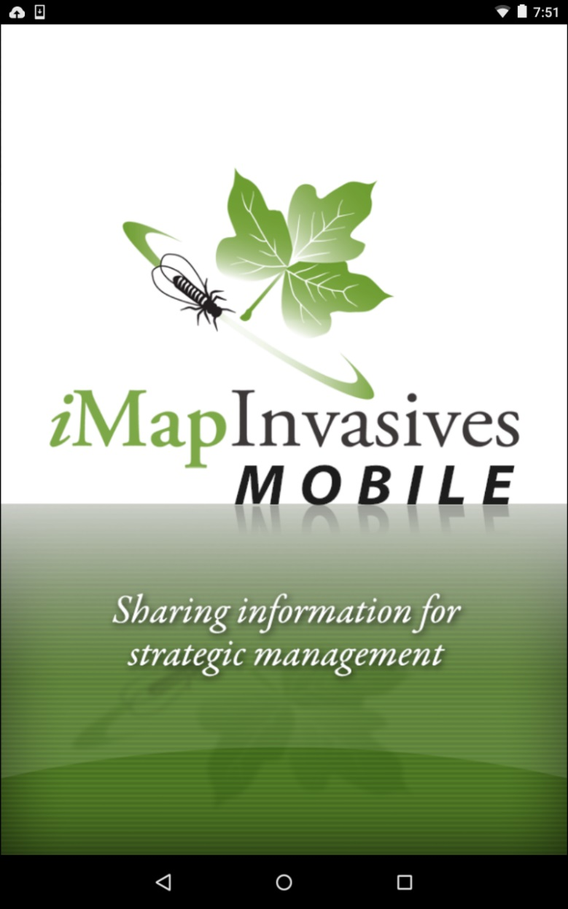
Observation Data-entry in the field… without connectivity
App - smartphone

Slide 37
Download iMapInvasives Mobile App
Method 1: OR Method 2:
Android: playstore
iPhone: AppStore
Download - FREE
Phone Browser:
(e.g. Chrome or Safari)
http://www.nyimapinvasives.org/ “Mobile” tab
Click icon
Download - FREE
Search:
“imapinvasives mobile”

Slide 38
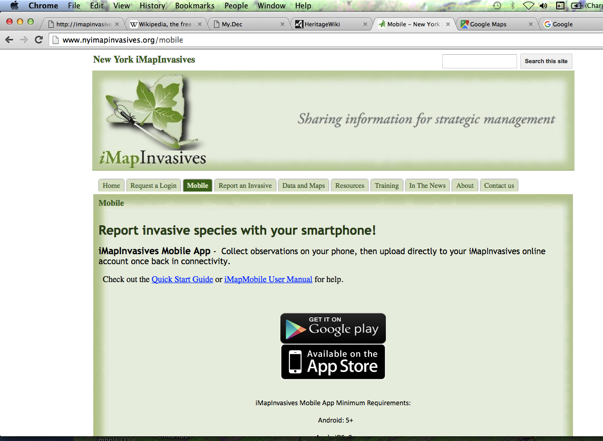
Method 2:
www.NYimapinvasives.org
Notes:
On your phone, with safari or chrome
Go to Nyimapinvasives.org
Click on “Mobile” Tab
Then, click on icon for PlayStore or AppStore
ALSO: app has minimum requirements – listed there
AND: this page is a great resource for later – quick start – one pager – and the User manual for review/questions

Slide 39




How to: Turn on Location Services (iPhone)
Notes:
4 clicks

Slide 40


How to: Turn on Location Services (Android)

Slide 41



Open the App
& Set Preferences
Username = iMap Username
first three letters of first name
last name (in full)
EXAMPLE: johsmith
PASSWORD: “changeme2018”
Notes:
NOW; downloaded & location services are on…
OPEN app… first time → Set Preferences opens
Under menu bars
PROJECT: water chestnut – if not there, then click on the UPDATE states data

Slide 42


Preferences:
Custom species list
“Presence”
Hemlock Wooly Adelgid
“Absence”
X-HWA NOT Detected
Comments:
Search effort - # trees & # branches
Notes:
MEG: get X, too; Set custom species list

Slide 43
Menu Bars
Help Text

Slide 44

Add
Observation
Take Photo
Tips:
Close other mapping apps
Make sure the phone’s GPS is on and allowed to talk to the app
Project
Default in Preferences
Select species
Uncheck to move point
Comment – “X” – Search Effort
Notes:
Tap to get passed transparency
PHOTOS – Good photo – white background – keys for scale reference

Slide 45

“Fake Species (for testing)”
Comments: “Test”

Slide 46
In Field
No Connectivity
No map
GPS On
Coordinates
  With 73-ish & 42-ish;
  NOT “0,0”
Notes:
0, 0 ?
Equator, South of Greenwich – off the coast of Africa

Slide 47



How to: Upload Your Point
(Wifi suggested)
Notes:
Group of 10

Slide 48



“Cards” phone → iMap
Notes:
going from your phone to iMap
When upload is successful, cards are no longer on your screen; not on your phone

Slide 49





Test & Then View Online
Username = iMap Username
Check email
Default: xxxzzzzzzz
X = first three letters of first name
Z = last name (in full)
Notes:
Test in your neighborhood; garlic mustard, or purple loosestrife, or phragmites; Make sure username is correct, photo uploading OK, etc.
View Map & View Table
Then ready to go and Search for water chestnut

Slide 50
LIVE – Check Table

Slide 51

Test & Then View Online
Notes:
Test in your neighborhood; garlic mustard, or purple loosestrife, or phragmites; Make sure username is correct, photo uploading OK, etc.
View Map & View Table
Then ready to go and Search for water chestnut

Slide 52

Test & Then View Online
Notes:
Test in your neighborhood; garlic mustard, or purple loosestrife, or phragmites; Make sure username is correct, photo uploading OK, etc.
View Map & View Table
Then ready to go and Search for water chestnut

Slide 53

Test & Then View Online
Notes:
Open the record…

Slide 54

Online – Add Photos

Slide 55
Test & Then View Online
Notes:
While you are online…

Slide 56
Intro
PRISMs Partnerships for Regional Invasive Species Management
Importance of Early Detection
Online – Map & Table
Online – Query/Report & Email Alerts
iMapInvasives
Online
iMapInvasives
App
App – Download/Set Preferences
App – Record an Observation
App - Upload; Test & View Online
Wrap-Up
8 Things You Can Do – by Megan Phillips
Questions
Notes:
Overview of state efforts – ISAW and PRISMs
Let you know about iMap, a resource available to you
And want to empower you to have an iMap login and know how to submit an observation from your phone
FLY IN
Special today – trying to make this as close to in-person as possible
iMap Section – follow along
PLUS Tech hour – personal assistance via phone and email

Slide 57

Things You Can Do
From Megan Phillips
Don’t Move Firewood
Clean, Drain, Dry boat/kayak, etc
Know Before You Grow (“Plant Native”)
Don’t Let It Loose (exotic pets/fish)
Play, Clean, Go bike/4-wheel/hiking shoes
Don’t take the (Invasive) Bait
Report to iMap
Keep Up With Your PRISM
Notes:
Megan did a presentation on 8 Things you can do for an event we did during ISAW – full presentation available at the ISAW blog

Slide 58
READY to Search ☺
Know how to ID some invasive species
App downloaded to smartphone
Local observation point uploaded to iMap
Checked local obs point - online iMap (view Map & view Table)
Checked online for known invasive species locations
Notes:
NOW ready – app loaded; app tested; water chestnut ID Good Goal is to find infestations when they are small and manageable
If found early, small infestation → manageable

Slide 59


Comments:
Search effort - # trees & # branches
Notes:
In the field; eyes on the ground; detective

Slide 60

Questions?
http://www.nyimapinvasives.org
Email: imapinvasives@dec.ny.gov
Thank You!
Notes:
Please ask questions now
iMap is here to help anyone in the state working on Invasive species issues; please do not hesitate to contact us

